Slide 1
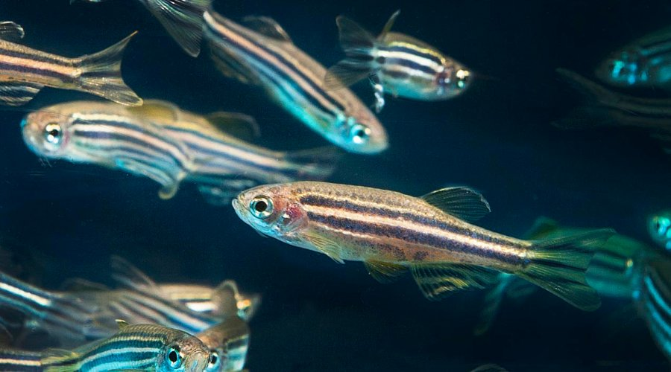
How Did the Zebrafish Get Its Stripes? Phase Separation in Biological Tissues
Eloise Lardet
Mary Lister McCammon Summer Fellowship
Supervised by: Dr Thibault Bertrand & Dr Gunnar Pruessner

Slide 2
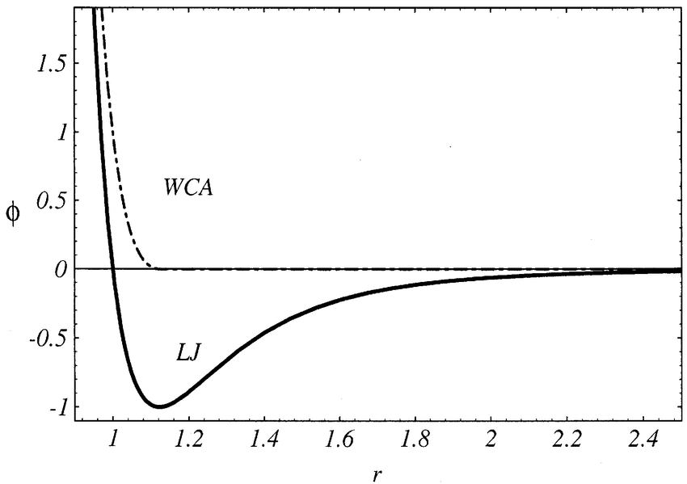
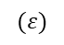
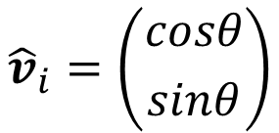
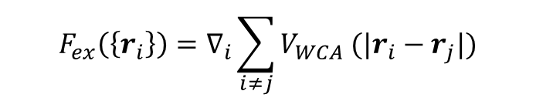
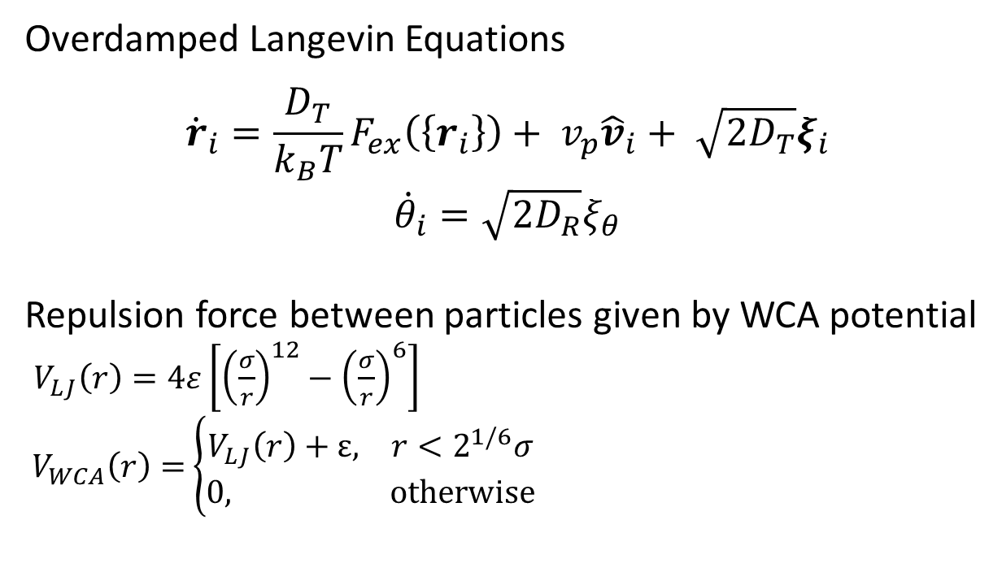
One Population Modelling
Active Brownian particles with repulsive interactions
Overdamped Langevin Equations
$${\dot{r}}_{i}=\frac{D_{T}}{k_{B}T}F_{ex}\left(\left\{r_{i}\right\}\right)+ v_{p}{\hat{v}}_{i}+ \sqrt{2D_{T}}ξ_{i}$$
$${\dot{θ}}_{i}=\sqrt{2D_{R}}ξ_{θ}$$
Repulsion force between particles given by WCA potential
$V_{LJ}\left(r\right)=4ε\left[{\left(\frac{σ}{r}\right)}^{12}−{\left(\frac{σ}{r}\right)}^{6}\right]$
$V_{WCA}\left(r\right)=$ $\left\{\begin{aligned}V_{LJ}\left(r\right)+ε, r<2^{1/6}σ \\ 0, otherwise\end{aligned}\right.$
$${\hat{v}}_{i}=\left({cosθ \atop sinθ}\right)$$
$$(ε)$$
$$F_{ex}\left(\left\{r_{i}\right\}\right)=∇_{i}\sum_{i≠j}{V_{WCA} (|r_{i}−r_{j}|)}$$

Slide 3
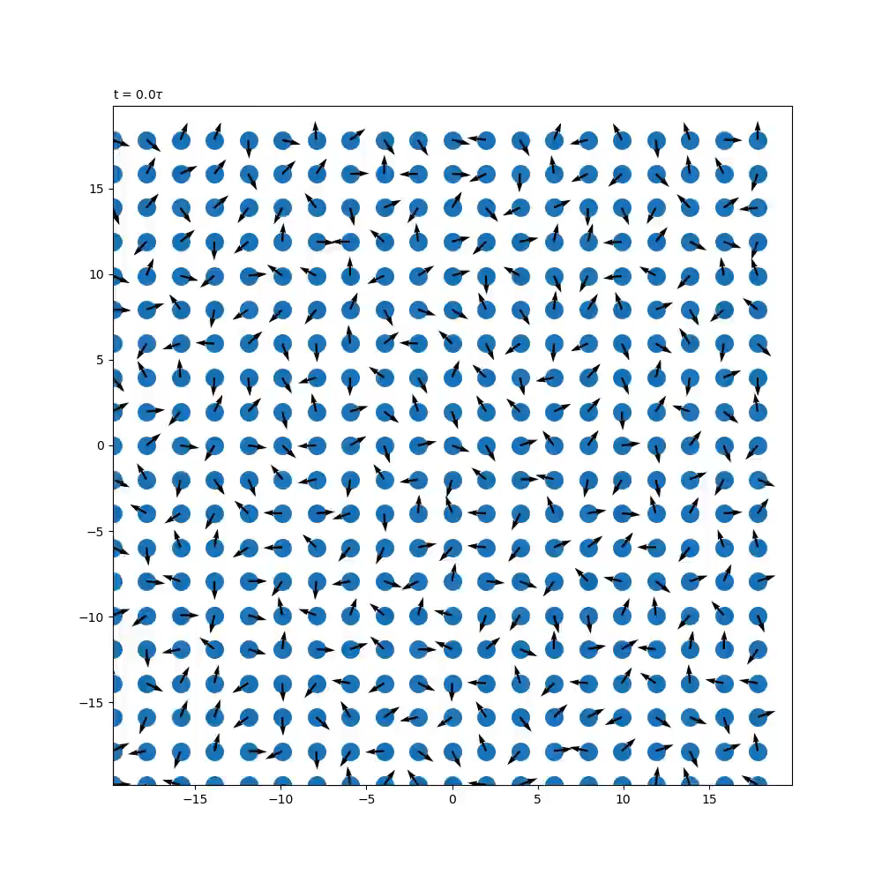
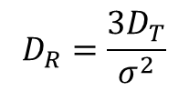
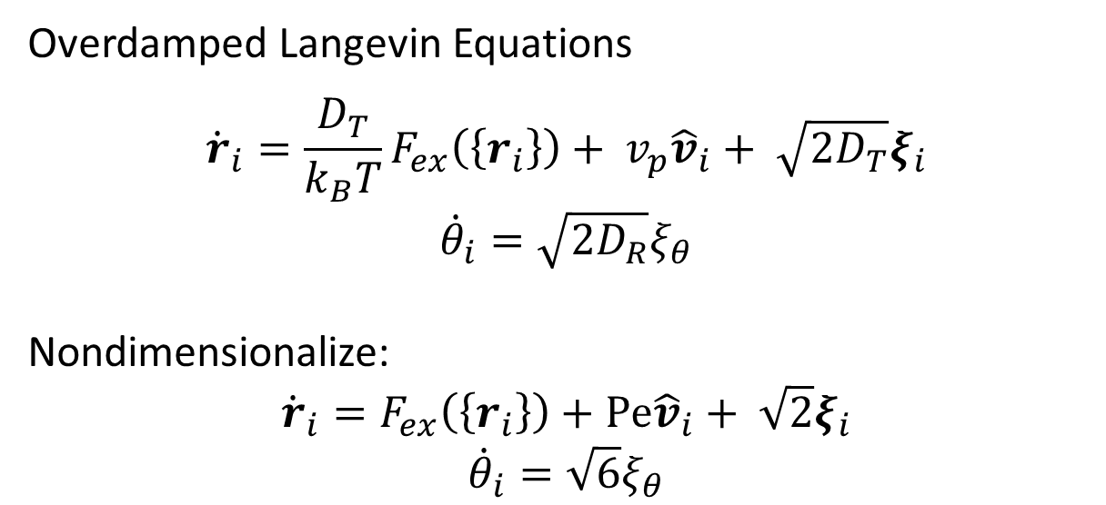
One Population Modelling
Active Brownian particles with repulsive interactions
$$D_{R}=\frac{3D_{T}}{σ^{2}}$$
Overdamped Langevin Equations
$${\dot{r}}_{i}=\frac{D_{T}}{k_{B}T}F_{ex}\left(\left\{r_{i}\right\}\right)+ v_{p}{\hat{v}}_{i}+ \sqrt{2D_{T}}ξ_{i}$$
$${\dot{θ}}_{i}=\sqrt{2D_{R}}ξ_{θ}$$
Nondimensionalize:
$${\dot{r}}_{i}=F_{ex}\left(\left\{r_{i}\right\}\right)+Pe{\hat{v}}_{i}+ \sqrt{2}ξ_{i}$$
$${\dot{θ}}_{i}=\sqrt{6}ξ_{θ}$$
Use numerical methods to solve SDE
Euler for SDEs (first order)
Stochastic RK method (second order)

Slide 4
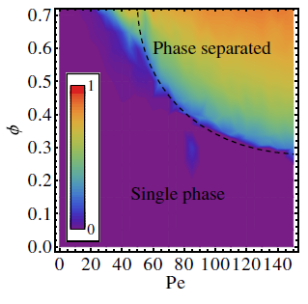
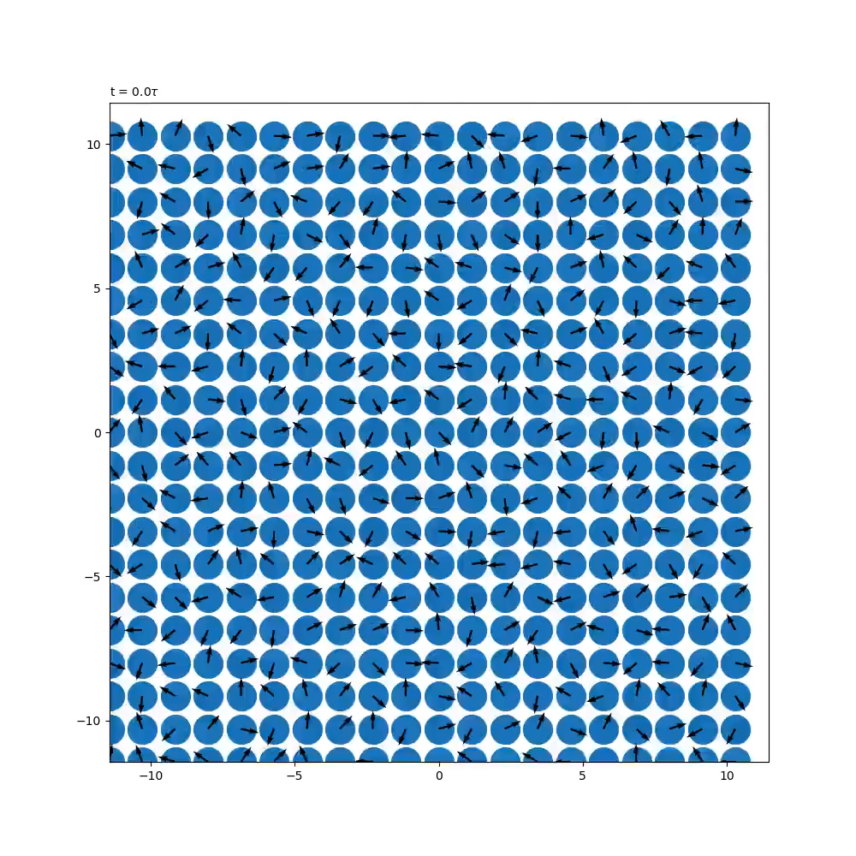
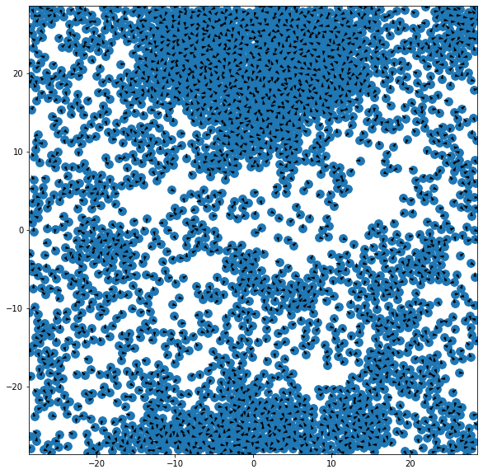



One Population: MIPS
Redner, G. S., Hagan, M. F., & Baskaran, A. (2013). Structure and Dynamics of a Phase-Separating Active Colloidal Fluid. Physical Review Letters, 110(5), 055701.
$$N=400; φ=0.2; Pe=120$$
$$N=400; φ=0.6; Pe=120$$
$$N=2500;φ=0.6;Pe=120$$

Slide 5
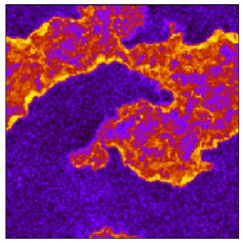
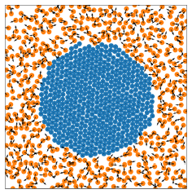
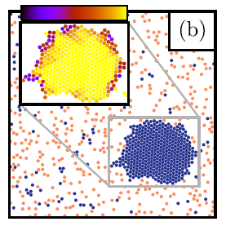
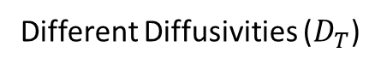
Two Population Modelling
Phase separation/ demixing in the literature
Different Peclet
(Passive and active particles)
Different Speeds
Different Diffusivities ($D_{T}$)
Stenhammar, J., Wittkowski, R., Marenduzzo, D., & Cates, M. E. (2015). Activity-Induced Phase Separation and Self-Assembly in Mixtures of Active and Passive Particles. Physical Review Letters, 114(1), 018301.
Baglietto, G., Seif, A., Grigera, T. S., & Paul, W. (2020). Otherwise identical particles with differing, fixed speeds demix under time-reversible dynamics. Physical Review E, 101(6), 062606.
Weber, S. N., Weber, C. A., & Frey, E. (2016). Binary Mixtures of Particles with Different Diffusivities Demix. Physical Review Letters, 116(5), 058301.

Slide 6
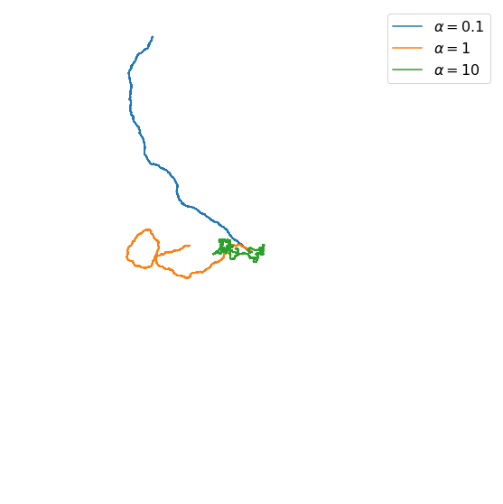
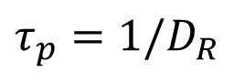
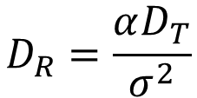
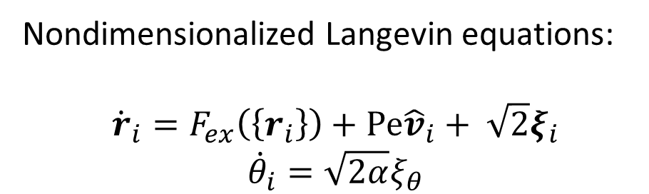
Two Population Modelling
Different Persistence
What if we change rotational diffusion?
Persistence Time
$$D_{R}=\frac{αD_{T}}{σ^{2}}$$
$$τ_{p}=1/D_{R}$$
Nondimensionalized Langevin equations:
$${\dot{r}}_{i}=F_{ex}\left(\left\{r_{i}\right\}\right)+Pe{\hat{v}}_{i}+ \sqrt{2}ξ_{i}$$
$${\dot{θ}}_{i}=\sqrt{2α}ξ_{θ}$$

Slide 7
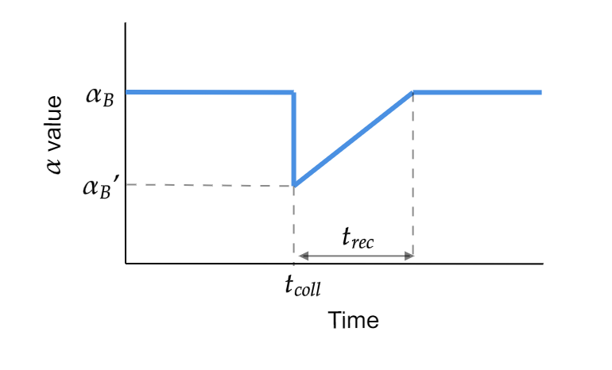
Two Population Modelling
Collisions and changing persistence
A
+
A
A
No change
B
+
B
B
No change
A
+
B
A
No change
B
Persistence increases!
Contact Inhibition of Locomotion

Slide 8
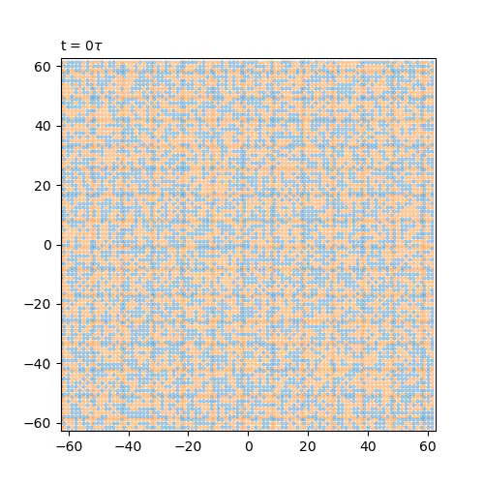
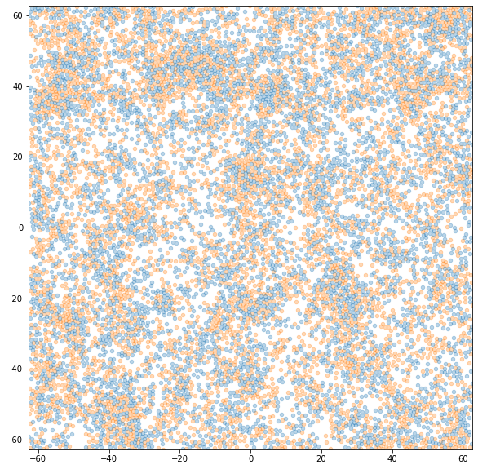
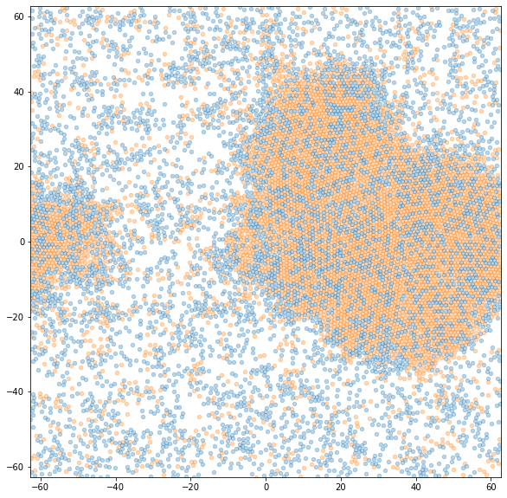
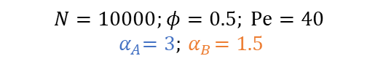
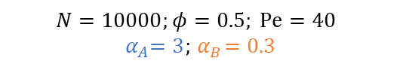
Two Population Modelling
Constant persistence
$$N=10000;φ=0.5; Pe=40$$
$${ α}_{A}=3;{ α}_{B}=1.5$$
$$N=10000;φ=0.5; Pe=40$$
$${ α}_{A}=3;{ α}_{B}=0.3$$

Slide 9
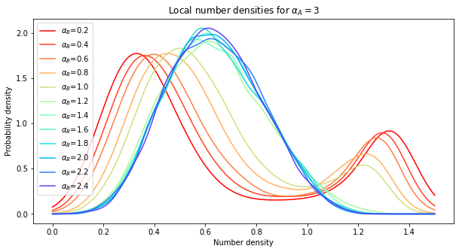
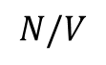
Two Population Modelling
Phase Separation
$$N/V$$

Slide 10
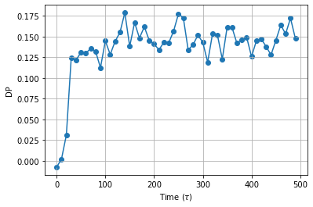

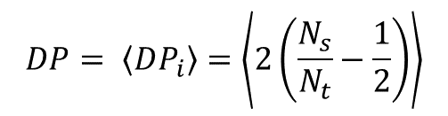
Two Population Modelling
Sahu, P., Sussman, D. M., Rübsam, M., Mertz, A. F., Horsley, V., Dufresne, E. R., et al. (2020). Small-scale demixing in confluent biological tissues. Soft Matter, 16(13), 3325–3337.
$$DP= \left\langle DP_{i}\right\rangle =\left\langle 2\left(\frac{N_{s}}{N_{t}}−\frac{1}{2}\right)\right\rangle$$
Demixing
$$N=10000;φ=0.5; Pe=40$$
$${ α}_{A}=3;{ α}_{B}=0.3$$

Slide 11
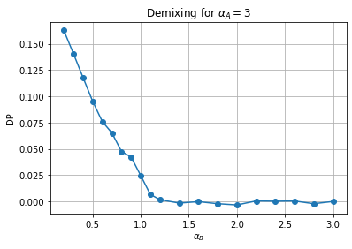
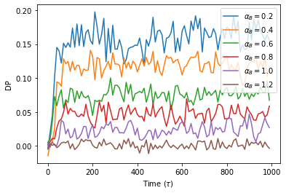
Two Population Modelling
Demixing

Slide 12
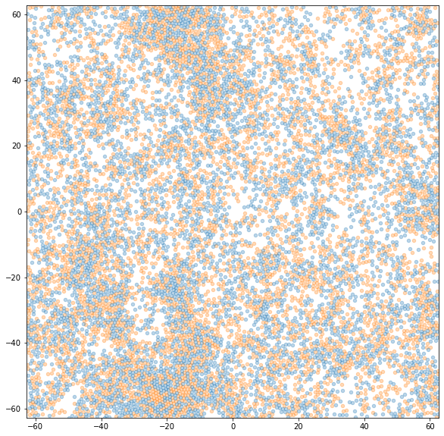
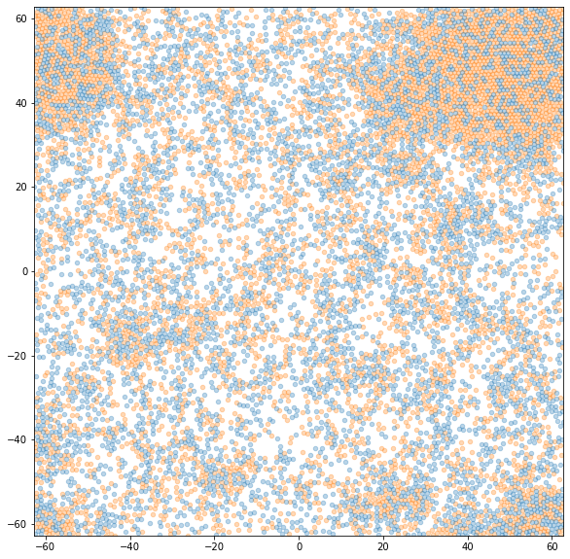
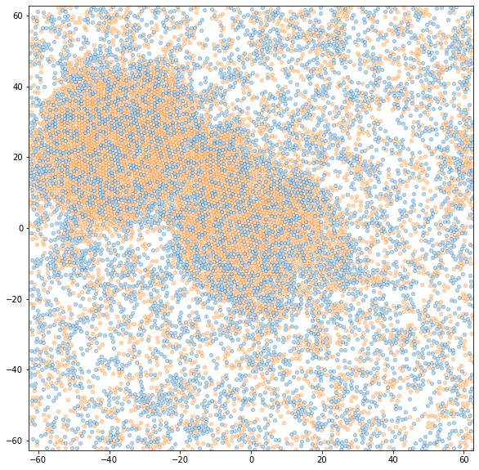
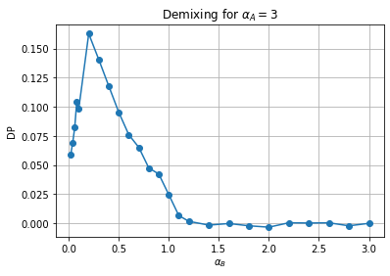
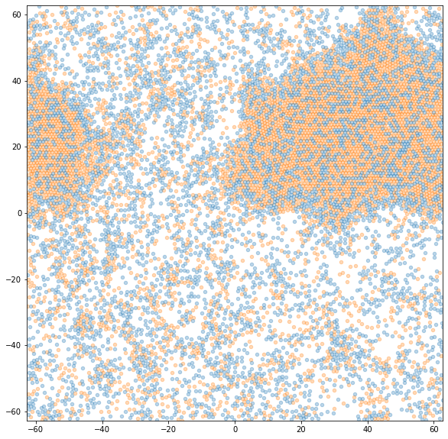
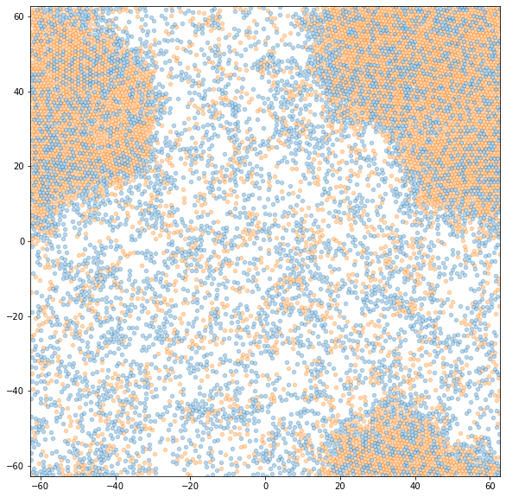
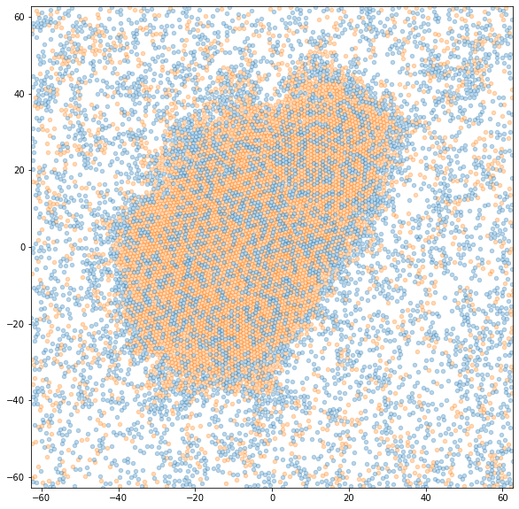
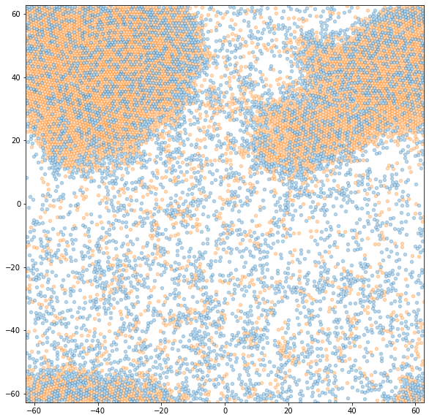
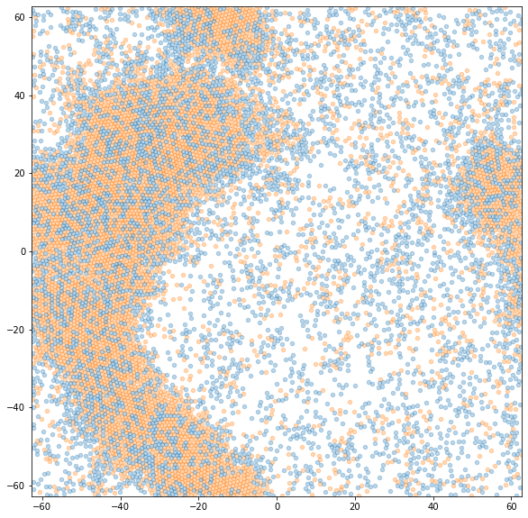
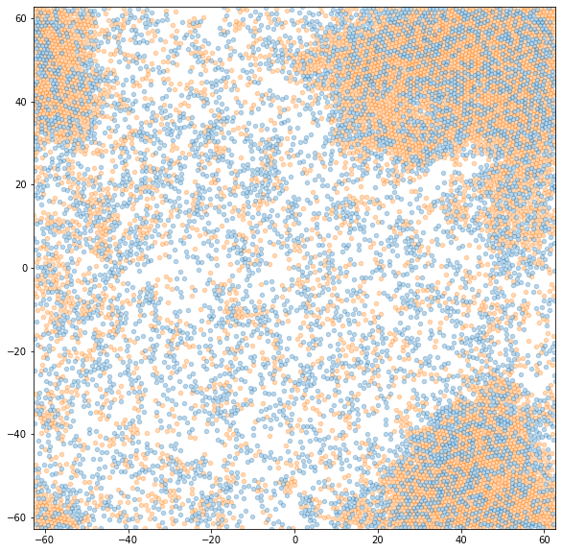
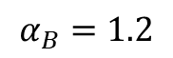
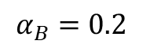
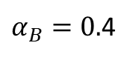
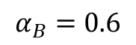
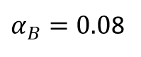
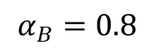
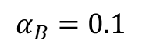
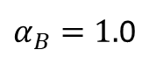

Two Population Modelling
Demixing
$$α_{B}=1.2$$
$α_{B}=1.$0
$$α_{B}=0.8$$
$$α_{B}=0.6$$
$α_{B}=0.$4
$$α_{B}=0.2$$
$$α_{B}=0.1$$
$α_{B}=0.0$8
$$α_{B}=0.02$$

Slide 13



Two Population Modelling
Demixing
$$N=10000;φ=0.5; Pe=40$$
$${ α}_{A}=3;{ α}_{B}=0.04$$

Slide 14

Other things to explore…
Phase diagrams/ critical values for phase separation and demixing
A particles in MIPS region?
Causes and physics explanations
Changing alpha with collisions model – relate to experimental data
Thanks for listening!

